Slide 1
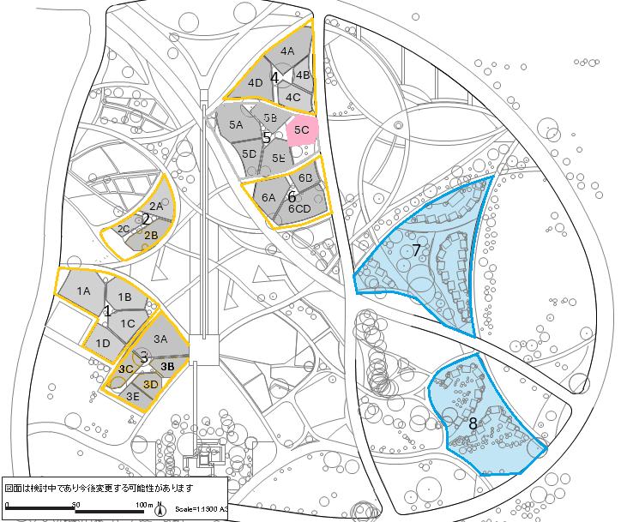
Appendix 1
5C: Serbia
Type I
Outdoor Exhibition Spaces
(Standard Type)
*For participants those construct garden and/or pavilion on their own expenses
Type I
Outdoor Exhibition Space
（International Garden Type）
*Mainly in-kind assistance for developing countries (provide approximately 20 sq.m. buildings per country)
Area No. | Plot
 | Plot No. | Size (Sq.m) | Total Size (Sq.m)
1 | 1A | 758 | 2,202
 | 1B | 527
 | 1C | 451
 | 1D | 466
2 | 2A | 436 | 1,055
 | 2B | 427
 | 2C | 192
3 | 3A | 834 | 2,010
 | 3B | 273
 | 3C | 359
 | 3D | 272
 | 3E | 272
4 | 4A | 663 | 1,934
 | 4B | 254
 | 4C | 397
 | 4D | 619
5 | 5A | 691 | 2,264
 | 5B | 343
 | 5C | 370
 | 5D | 380
 | 5E | 480
6 | 6A | 512 | 1,451
 | 6B | 276
 | 6C | 663
 | 6D

